Slide 1
Environment and requirements
The robot shall move efficiently, precisely and systematically
Gamezone of 2,5 x 1,5m
Assessing the deplacement, 6 points travel on the game area and back to position with less than 10cm error

Slide 2
How to move : classic non-directive wheels
Easy to use and structurally simpler than tracks or mecanum
Non directive : mechanically more simple
Front
Motor wheels
Top view
Left
Right
Free wheels for stability
Back

Slide 3
How to move : separation measure/motricity
Dilemna punctual contact vs acceleration
Split precision and efficience
Front
Top view
Rotary encoders
Back

Slide 4
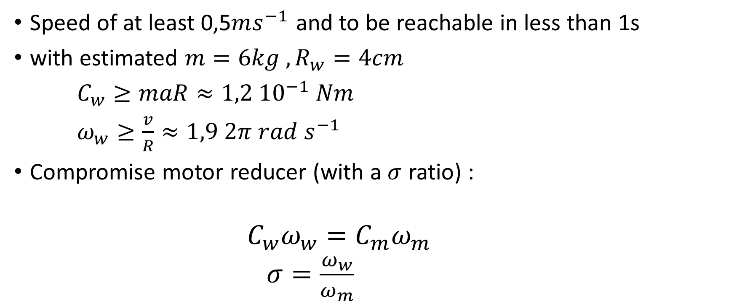
Need for speed : dimensionning motors
Speed of at least 0,5$ms^{−1}$ and to be reachable in less than 1s
with estimated $m=6kg , R_{w}=4cm$
$C_{w}≥maR≈1,2 {10}^{−1} Nm$
$ω_{w}≥\frac{v}{R}≈1,9 2π rad s^{−1}$
Compromise motor reducer (with a $σ$ ratio) :
$$C_{w}ω_{w}=C_{m}ω_{m}$$
$σ=\frac{ω_{w}}{ω_{m}}$

Slide 5
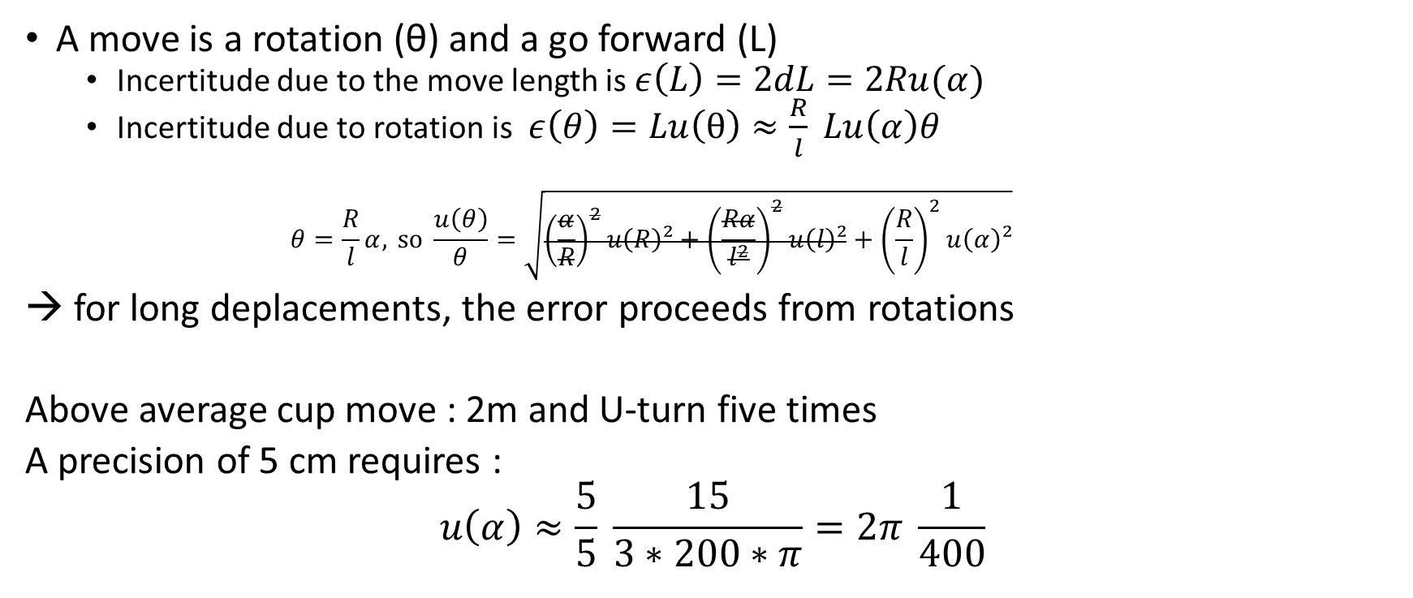
Moving precisely : what precision for the encoders?
A move is a rotation (θ) and a go forward (L)
Incertitude due to the move length is $ε\left(L\right)=2dL=2Ru(α)$
Incertitude due to rotation is $ε\left(θ\right)=Lu\left(θ\right)≈\frac{R}{l} Lu\left(α\right)θ$
$$θ=\frac{R}{l}α, \text{so} \frac{u\left(θ\right)}{θ}=\sqrt{{\left(\frac{α}{R}\right)}^{2}u\left(R\right)²+{\left(\frac{Rα}{l^{2}}\right)}^{2}u\left(l\right)²+{\left(\frac{R}{l}\right)}^{2}u\left(α\right)²}$$
→ for long deplacements, the error proceeds from rotations
Above average cup move : 2m and U-turn five times
A precision of 5 cm requires :
$$u\left(α\right)≈\frac{5}{5} \frac{15}{3∗200∗π}=2π \frac{1}{400}$$

Slide 6
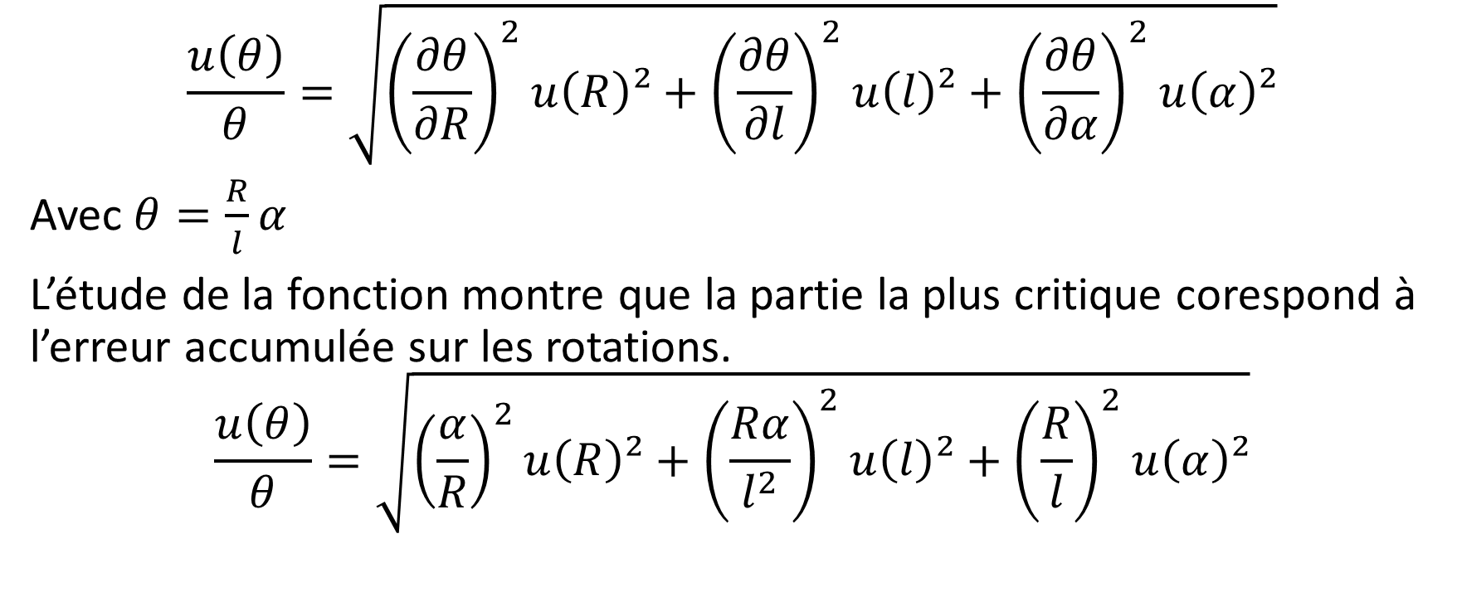
$$\frac{u\left(θ\right)}{θ}=\sqrt{{\left(\frac{∂θ}{∂R}\right)}^{2}u\left(R\right)²+{\left(\frac{∂θ}{∂l}\right)}^{2}u\left(l\right)²+{\left(\frac{∂θ}{∂α}\right)}^{2}u\left(α\right)²}$$
Avec $θ=\frac{R}{l}α$
L’étude de la fonction montre que la partie la plus critique corespond à l’erreur accumulée sur les rotations.
$$\frac{u\left(θ\right)}{θ}=\sqrt{{\left(\frac{α}{R}\right)}^{2}u\left(R\right)²+{\left(\frac{Rα}{l^{2}}\right)}^{2}u\left(l\right)²+{\left(\frac{R}{l}\right)}^{2}u\left(α\right)²}$$

Slide 7
TDR R1
The robot shall move efficiently and systematically
2m*3m (useful 2,5*1,5m without the balance and the opponent’s zone)
Error accepted in rotation and in length?
Precision 6 points 10 cm return (link strategy : 60 cm wide zones for pallets with color, targeting middle, need for <15cm error to bring back pallets)
Worst scenario 6 points very far from each other (approx 2m) with a complete U turn after each point.

Slide 8
Coding wheel : R, rotation α, dα
Lenght l
Θ

Slide 9
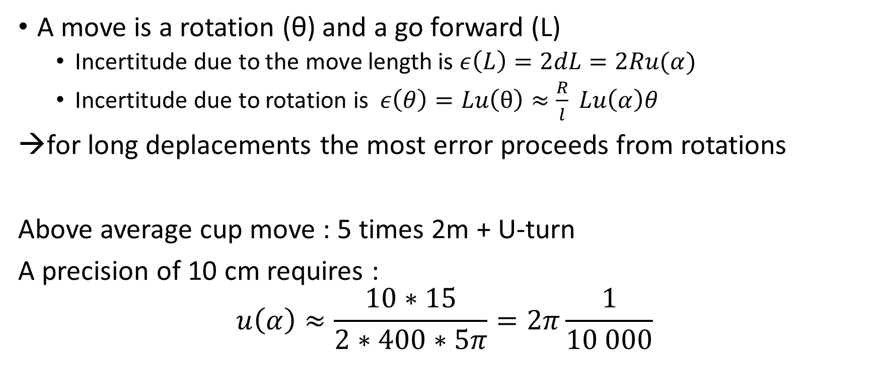
Moving precisely : what precision for the encoders?
A move is a rotation (θ) and a go forward (L)
Incertitude due to the move length is $ε\left(L\right)=2dL=2Ru(α)$
Incertitude due to rotation is $ε\left(θ\right)=Lu\left(θ\right)≈\frac{R}{l} Lu\left(α\right)θ$
→for long deplacements the most error proceeds from rotations
Above average cup move : 5 times 2m + U-turn
A precision of 10 cm requires :
$$u\left(α\right)≈\frac{10∗15}{2∗400∗5π}=2π\frac{1}{10 000}$$

